Slide 1
Dazed x SKP
Dazed x SKP
Dazed x SKP
GOODY BAG BRIEF
TIMING: The bags need to be delivered to the office latest by 6th June

Slide 2
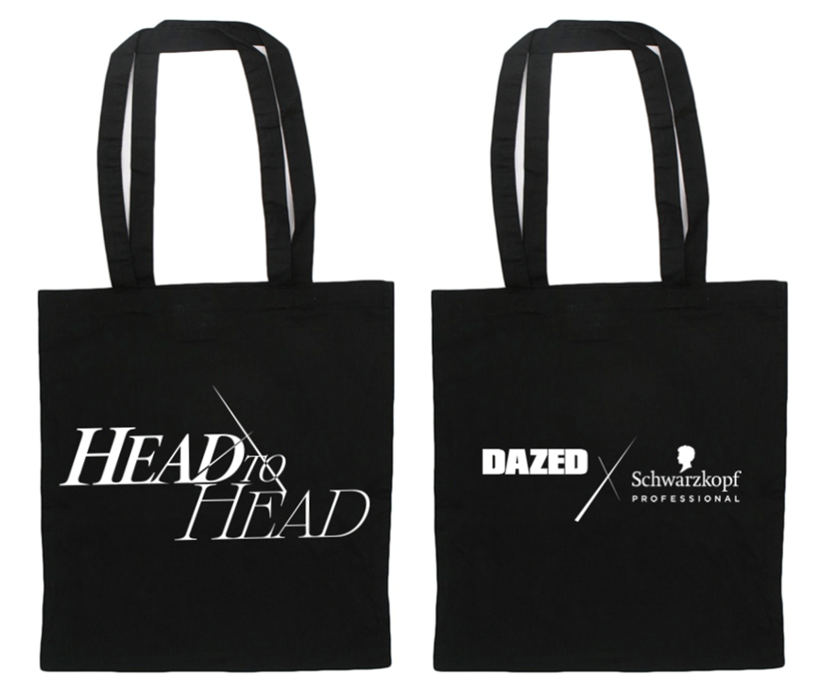
DESIGN - provided by dazed
NOTE: The design is not 100% final yet

Slide 3
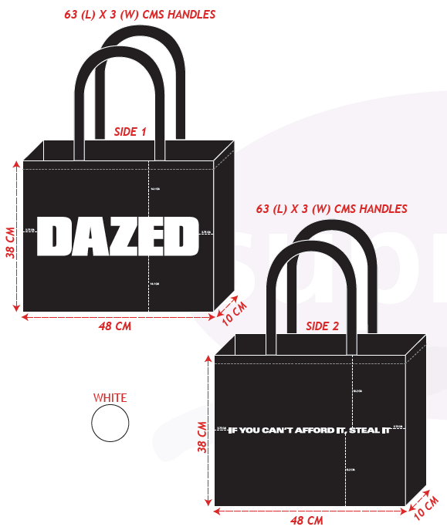
FORMAT & MATERIALS
MATERIAL BRIEF
Material: Character: Bag Colour: Print: Print Colour: Quantity: | cotton or canvas thick and valuable Black front and back (see design) white 300 pieces / 400 pieces (please provide 2 prices)

